Slide 1
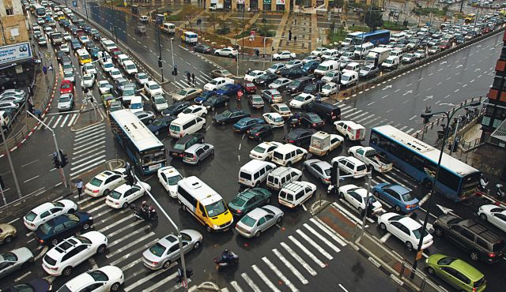
A Non-homogeneous Time Mixed Integer LP Formulation for Traffic Signal Control
Iain Guilliard, Scott Sanner, Felipe Trevizan, Brian Williams
Notes:
1. Title Slide: I'm going to talk about recent progress in how to globally optimize traffic signals using MILPS.

Slide 2
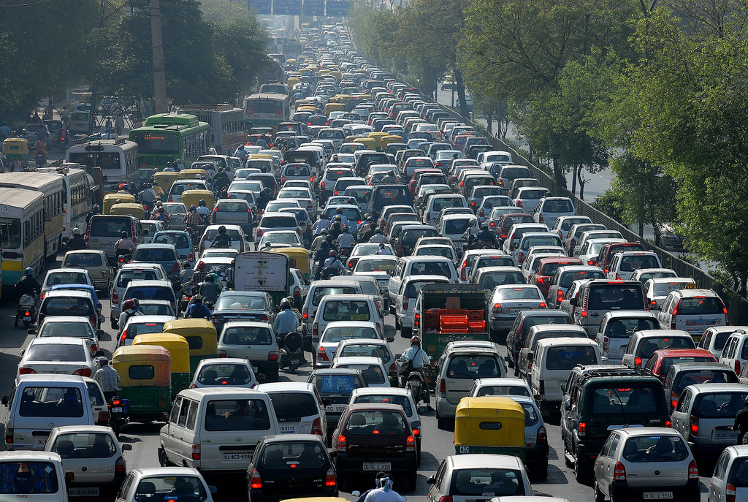
Motivation
Notes:
Fixed plan:
- not adaptive to changes in traffic
- fixed objective: worst case or average, etc
Adaptive:
- old - from 1960's
- reactive rather than predictive

Slide 3
Signal Control Methods
Suboptimal
Fixed Time Control
Adaptive Control: e.g. SCOOT and SCATS
Good: scalable, decentralized, cost
Bad: no performance guarantee
Locally optimal:
e.g. SURTRAC
Good: decentralized control
Bad: myopic
Globally optimal
e.g. CTM, LTM MILPs
Good: best solution possible
Bad: scalability
Notes:
Fixed-time: in practice, different plans for different times of day + actuation.
Optimal controllers: typically two parts: traffic model + optimization algorithm
Cost: EXPONENTIAL FUNCTION number of intersections by number of time samples

Slide 4
In this work
We present the Queue Transmission Model that:
Is globally optimal
We take advantage of the new developments in MILP solvers
Allows arbitrary topology
Grids and asymmetric intersections
Scales to many intersections
3 continuous variables, 1 binary per link
We use non-homogenous time steps to decrease the size of the problem

Slide 5
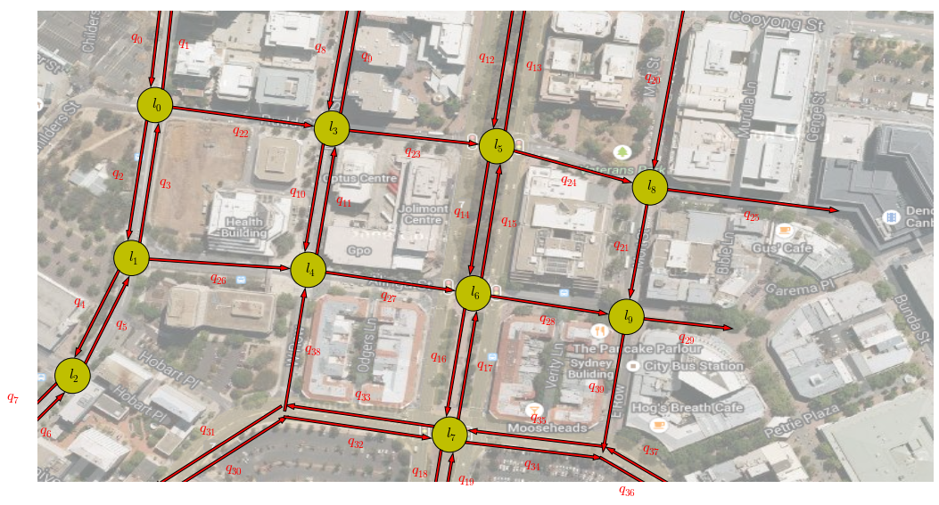
Homogeneous vs Non-Homogeneous
Time discretization:
Homogenous: uniform
Non-homogenous: arbitrary
Advantages of non-homogeneous:
Increase spatial horizon
Offers fidelity trade off
Non-Homogeneous
Homogeneous
Homogeneous
Non-Homogeneous
Notes:
Time Dilation

Slide 6
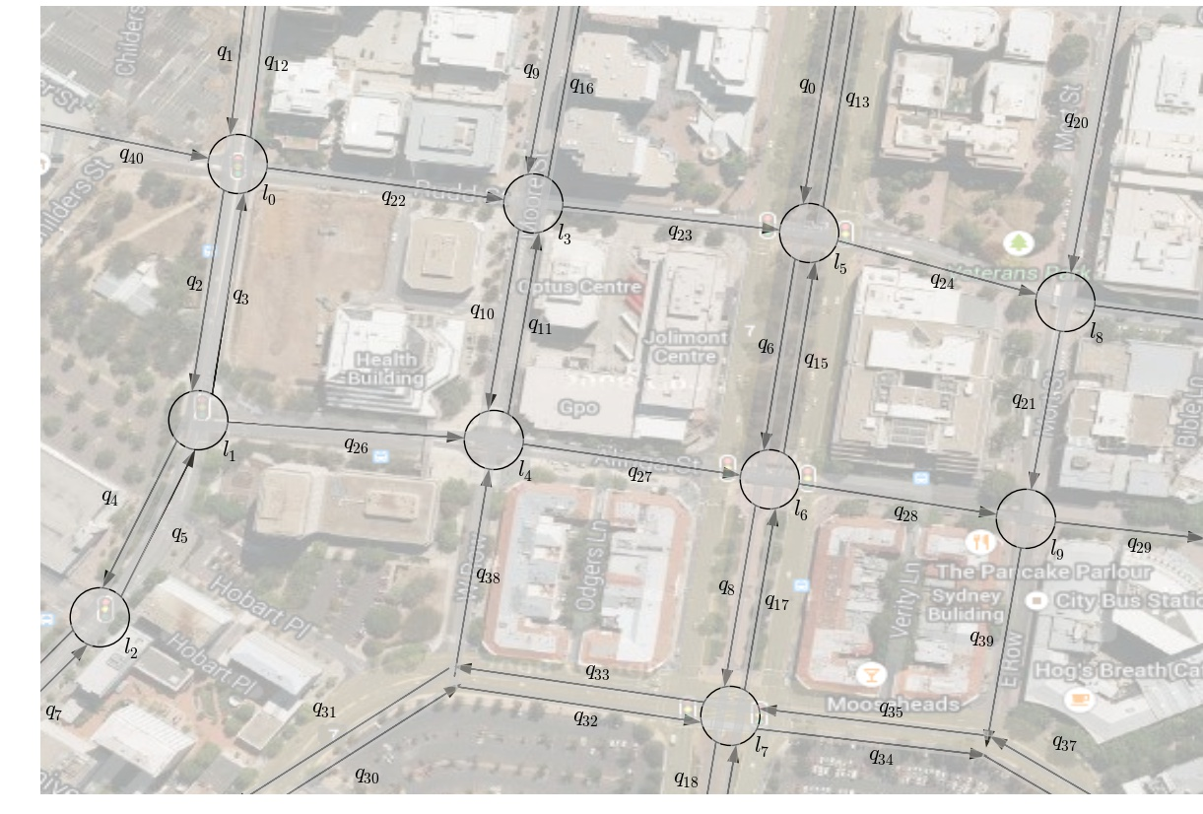
QTM Example

Slide 7
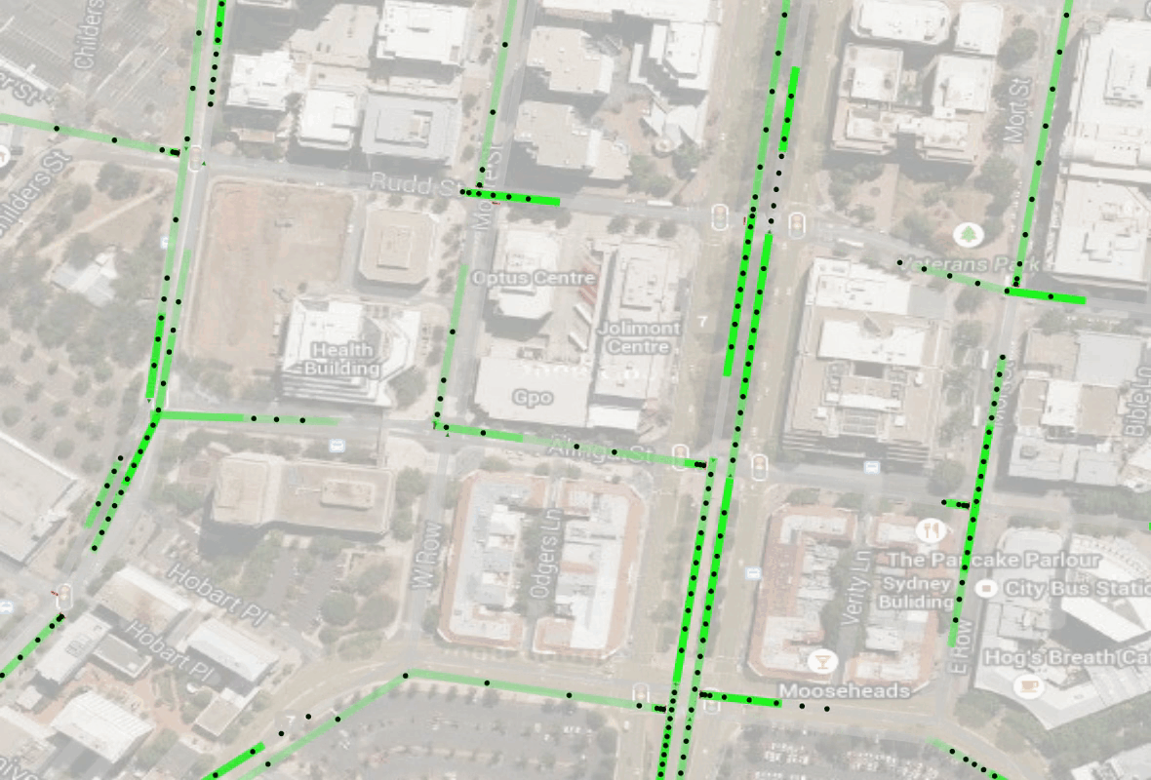
QTM Example – Flow with fixed control

Slide 8
QTM Example – Queuing Behavior

Slide 9
QTM Example – Platoons

Slide 10
QTM Example – Turn Probabilities

Slide 11
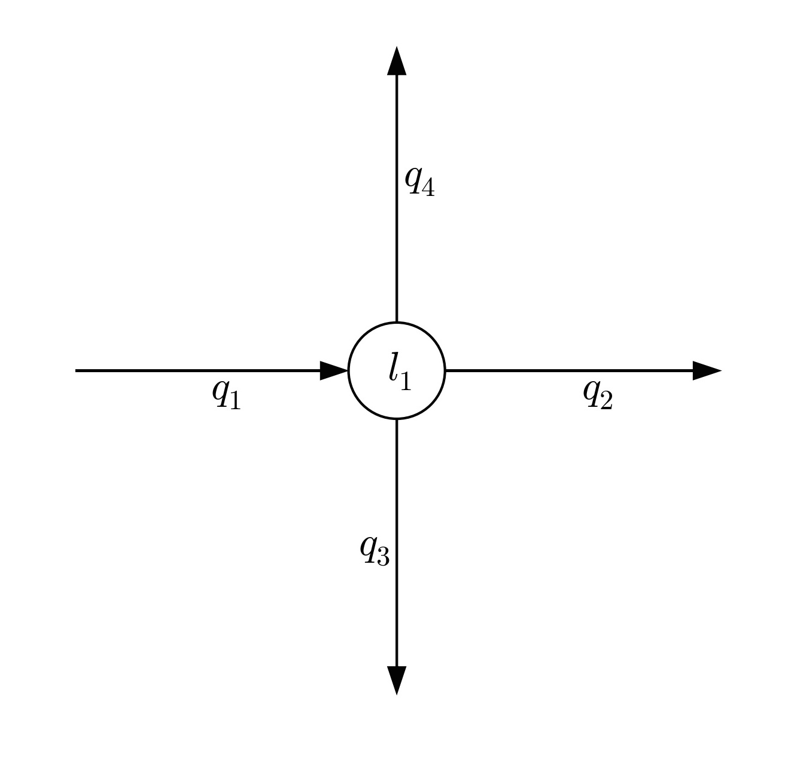
QTM – Variables and Parameters

Slide 12
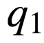
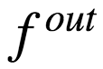
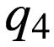
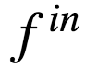
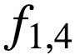
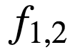
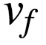
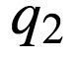
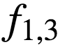
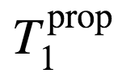
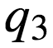
QTM – Variables and Parameters
F
I
F
O

Slide 13
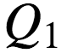
QTM – Variables and Parameters
FIFO
Notes:
Think of vertically stacked queue as horizontal that spills back up the approach

Slide 14
QTM – Variables and Parameters
free flow
congested
separating shockwave
Notes:
Folded together
Capture two regimes: free flow and congested with separating shock

Slide 15
QTM - Dynamics
free flow
congested
Link
traffic state
v_{f}
platoon
queue at light
QTM
CTM
3 cells
c₁
c₂
c₃
CTM
9 cells
c₁
c₂
c₃
c₄
c₅
c₆
c₇
c₈
c₉
Notes:
CTM based directly on wave equations
CTM fixed cell boundaries
CTM Mismatch cell boundaries mismatch with link boundaries

Slide 16
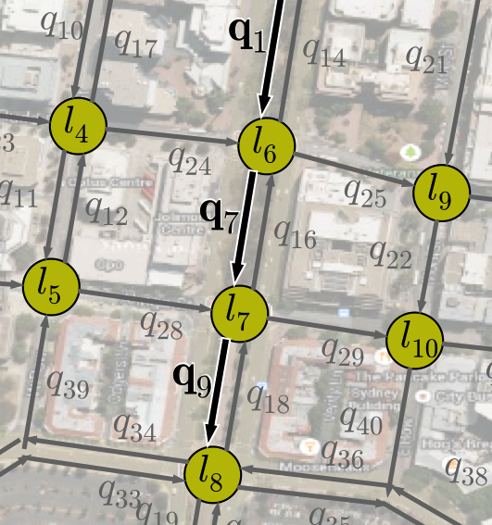
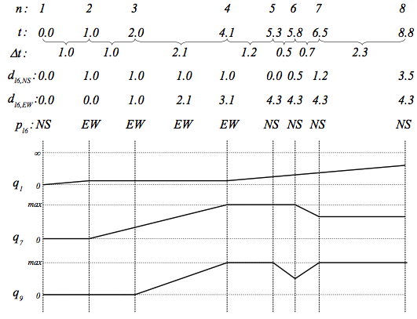
QTM – Non-homogeneous time steps

Slide 17
QTM – Non-homogeneous time steps

Slide 18
QTM – Non-homogeneous time steps

Slide 19
QTM – Non-homogeneous time steps

Slide 20
Discretization – Convergence
Time samples / planning horizon

Slide 21
Discretization – Convergence
Time samples / planning horizon

Slide 22
Discretization – Convergence
Time samples / planning horizon

Slide 23
Discretization – Dilation
Non-homogeneous “time dilation”
Time samples / planning horizon

Slide 24
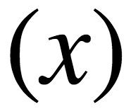
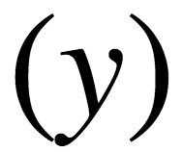
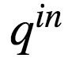
Integration V(x,y)
Notes:
Need to find volume of traffic that was travelled down link and arrived at the stopline during current interval
Integration components identified in a pre computation step

Slide 25
Integration V(x,y)

Slide 26
Integration V(x,y)

Slide 27
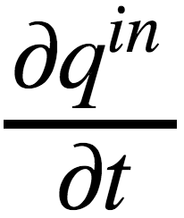
Integration V(x,y)

Slide 28
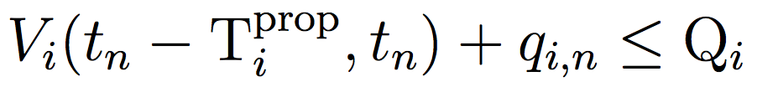
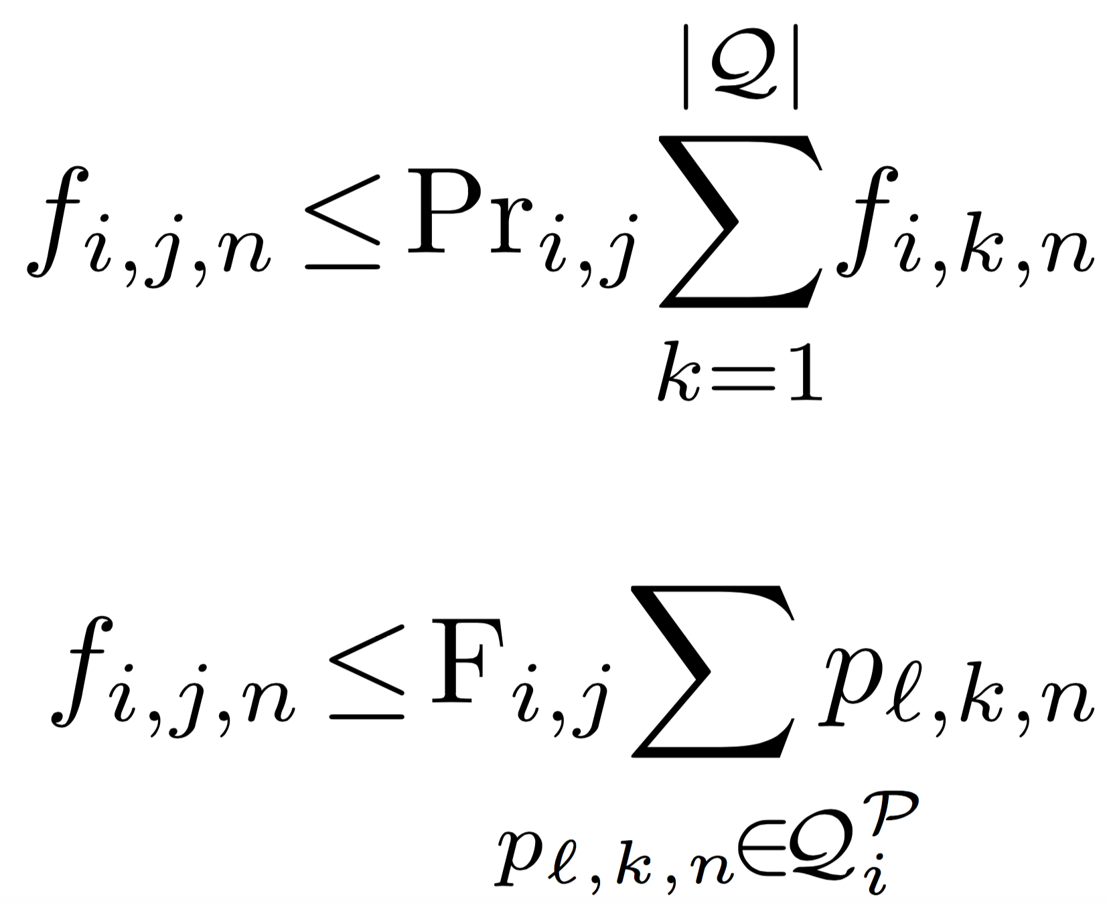
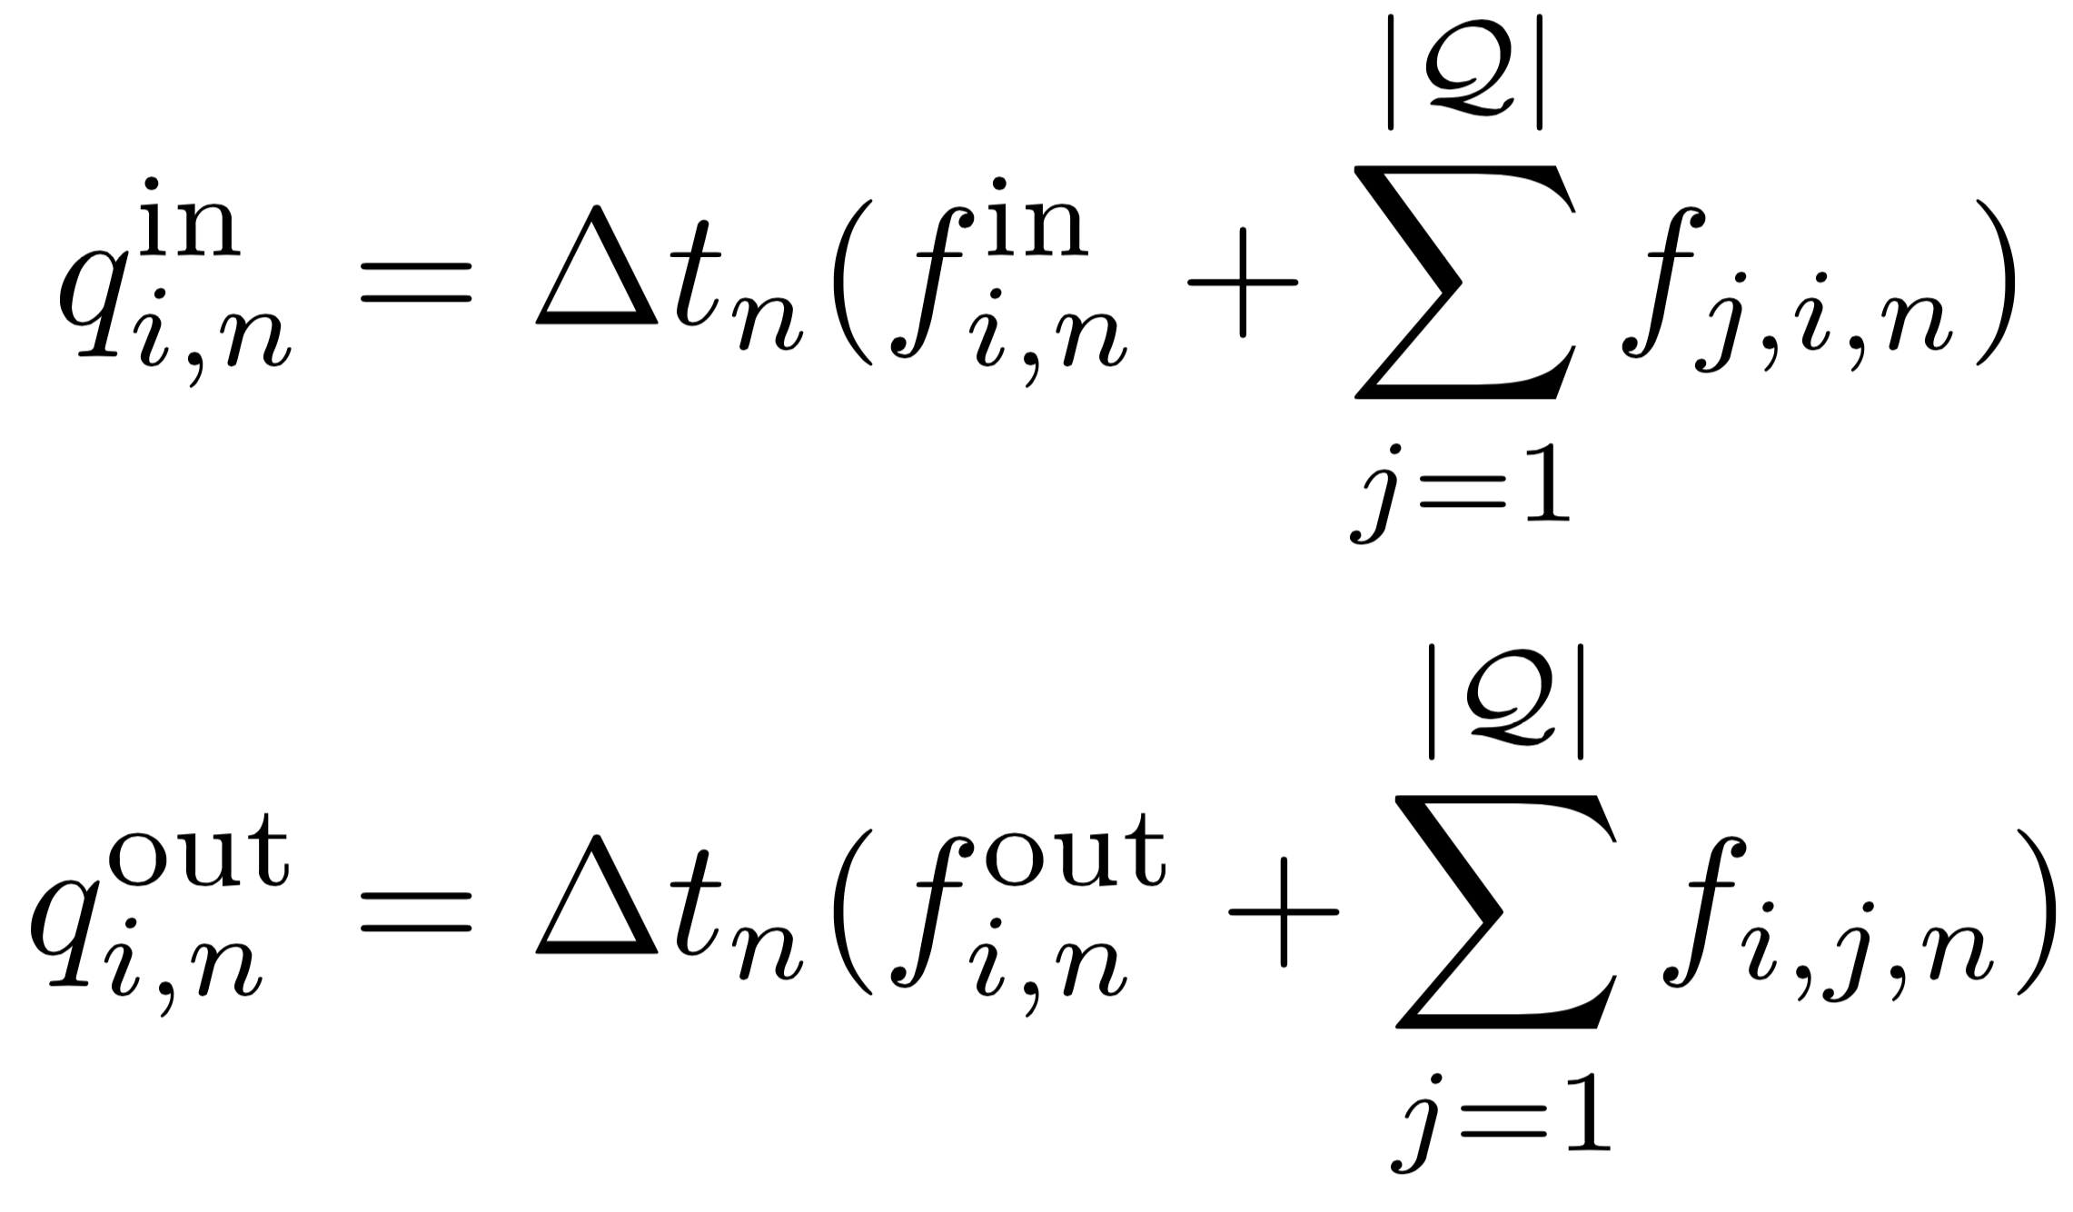
Update Step
Traffic arriving at stop line during interval n
Limit link capacity
Turn probabilities
Inflows
Signal modulation
Outflows

Slide 29
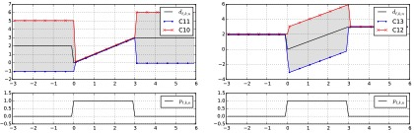
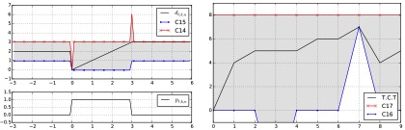
Phase & Cycle Duration Control
Ramp
Hold
Reset
Cycle time

Slide 30
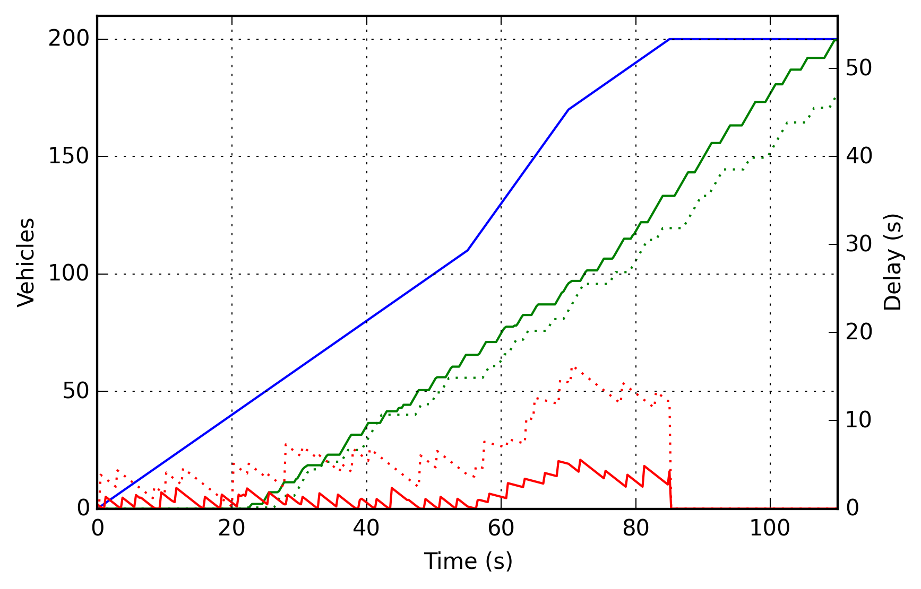
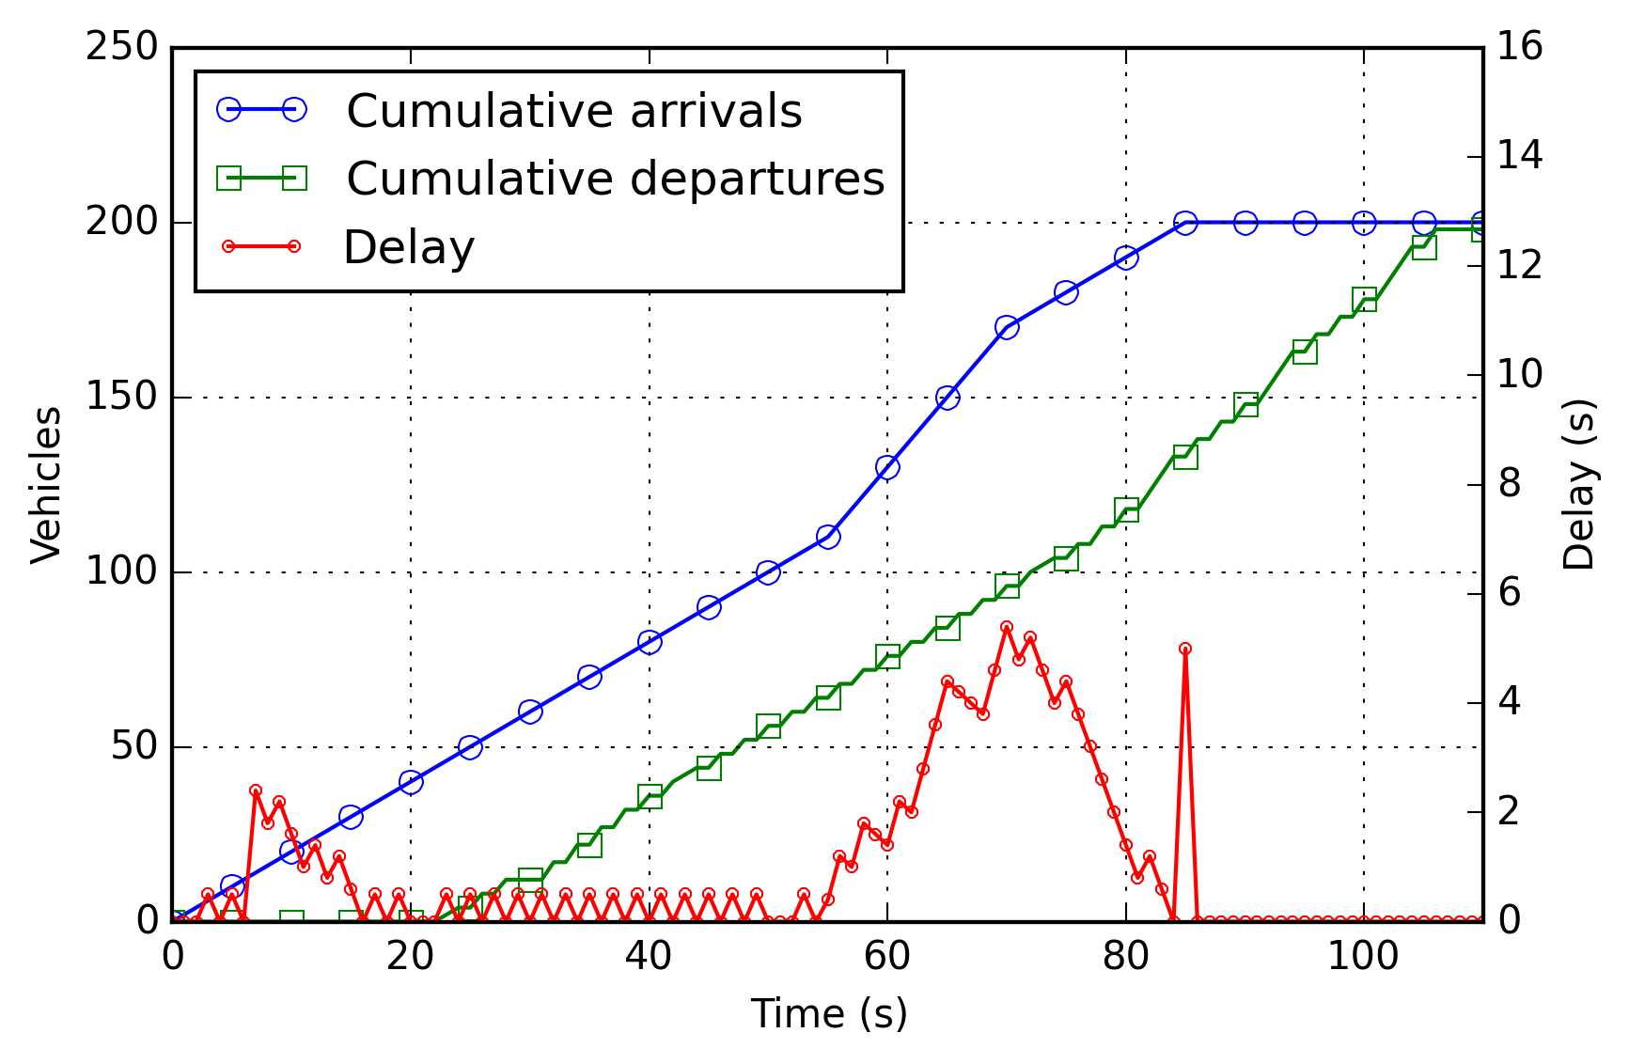
Objective Function
Travel Time
Out flow
In flow
Delay

Slide 31
Objective Function
Travel Time
Out flow
In flow
Delay

Slide 32
Objective Function
Travel Time
Out flow
In flow
Delay

Slide 33
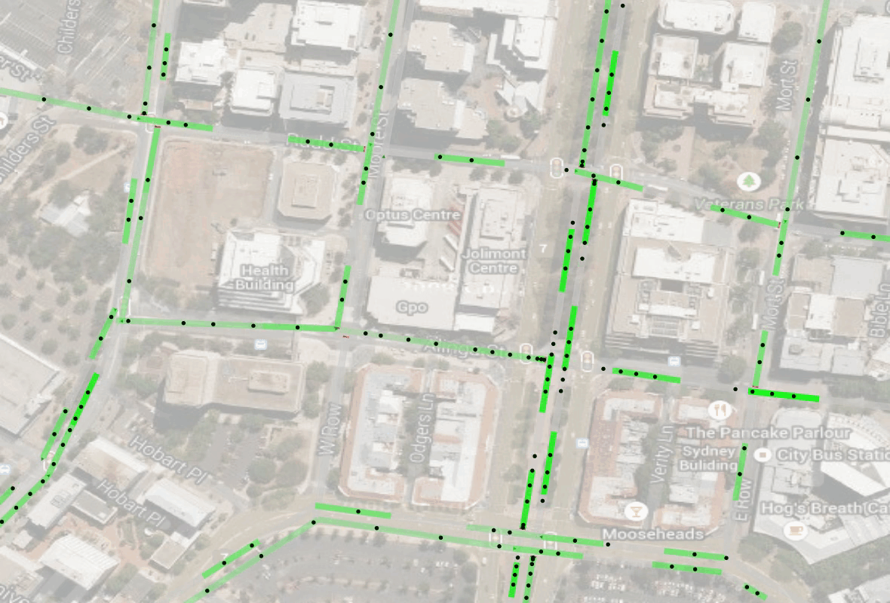
QTM Example: with optimized control

Slide 34
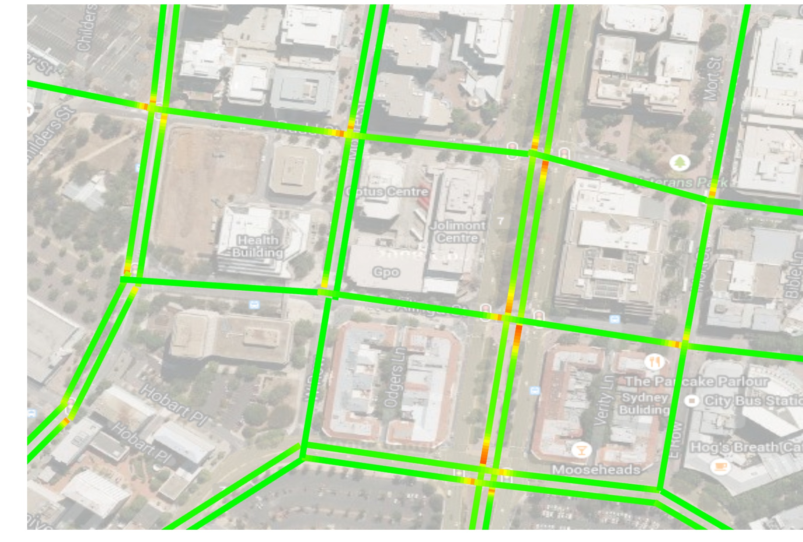
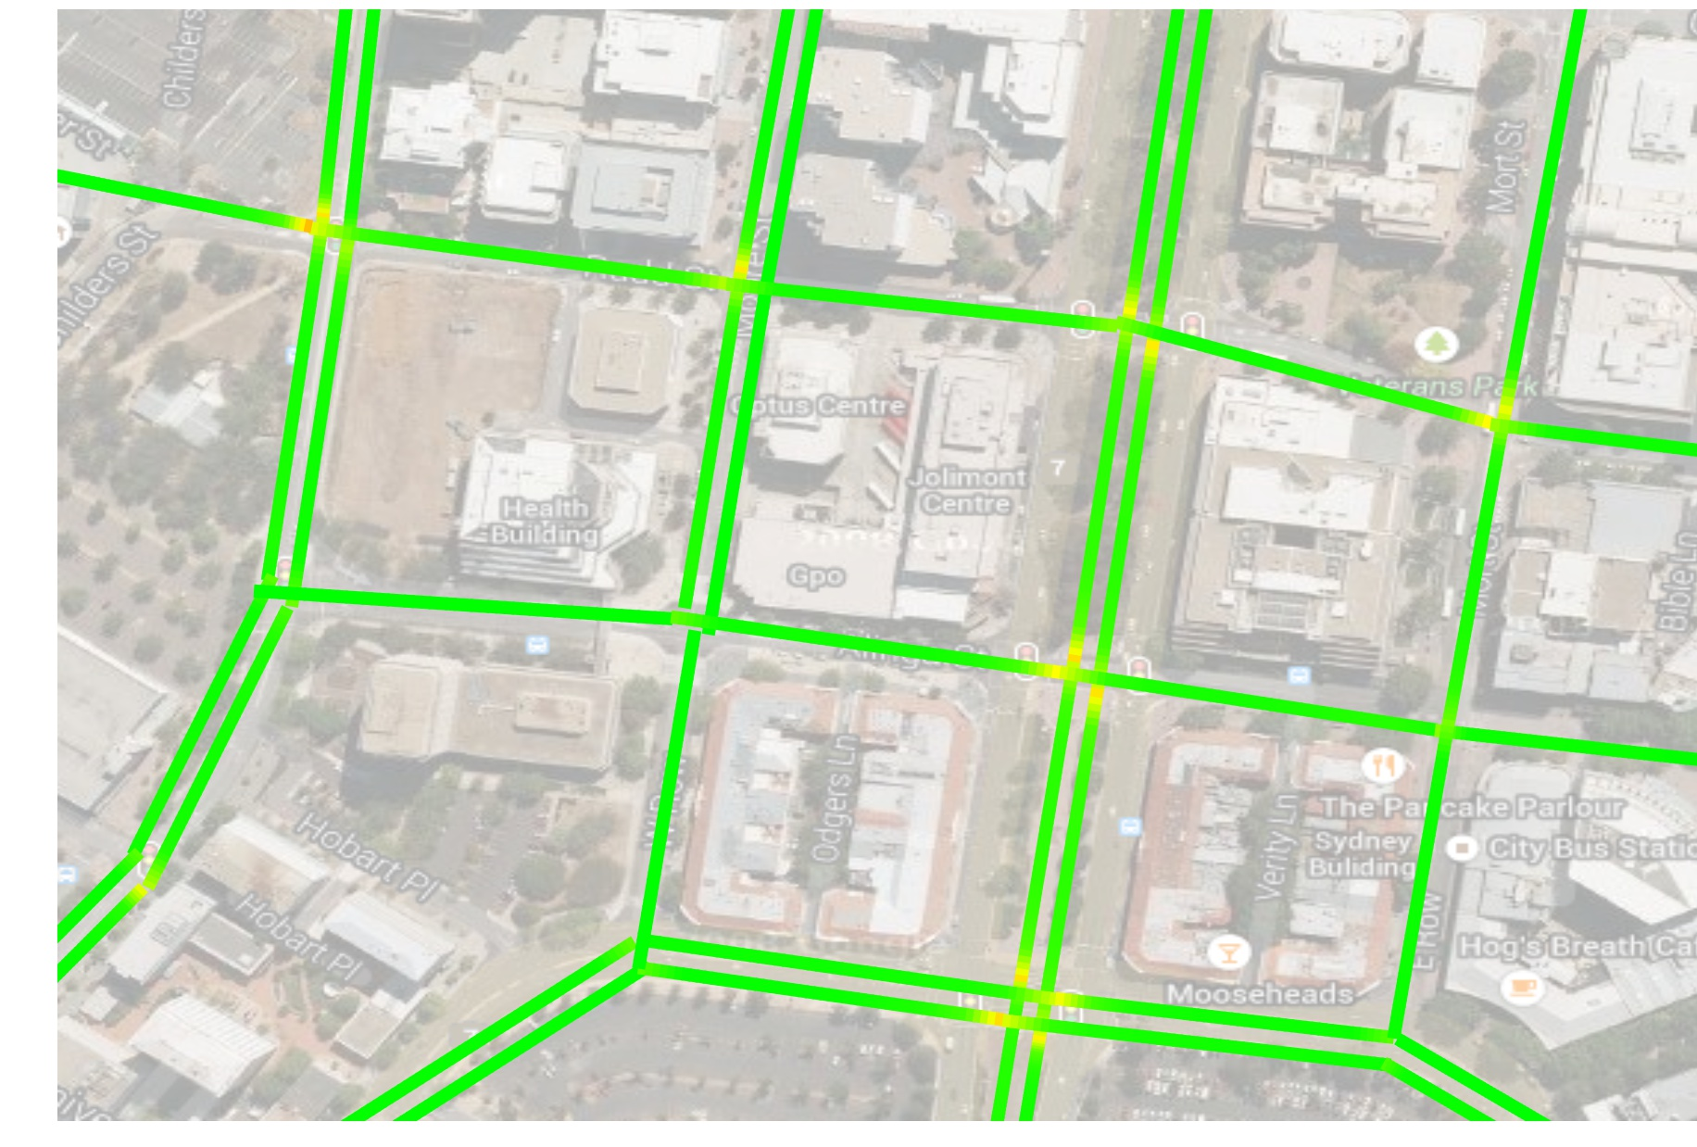
Example: Delay Map, fixed vs optimized
Fixed
QTM Optimized

Slide 35
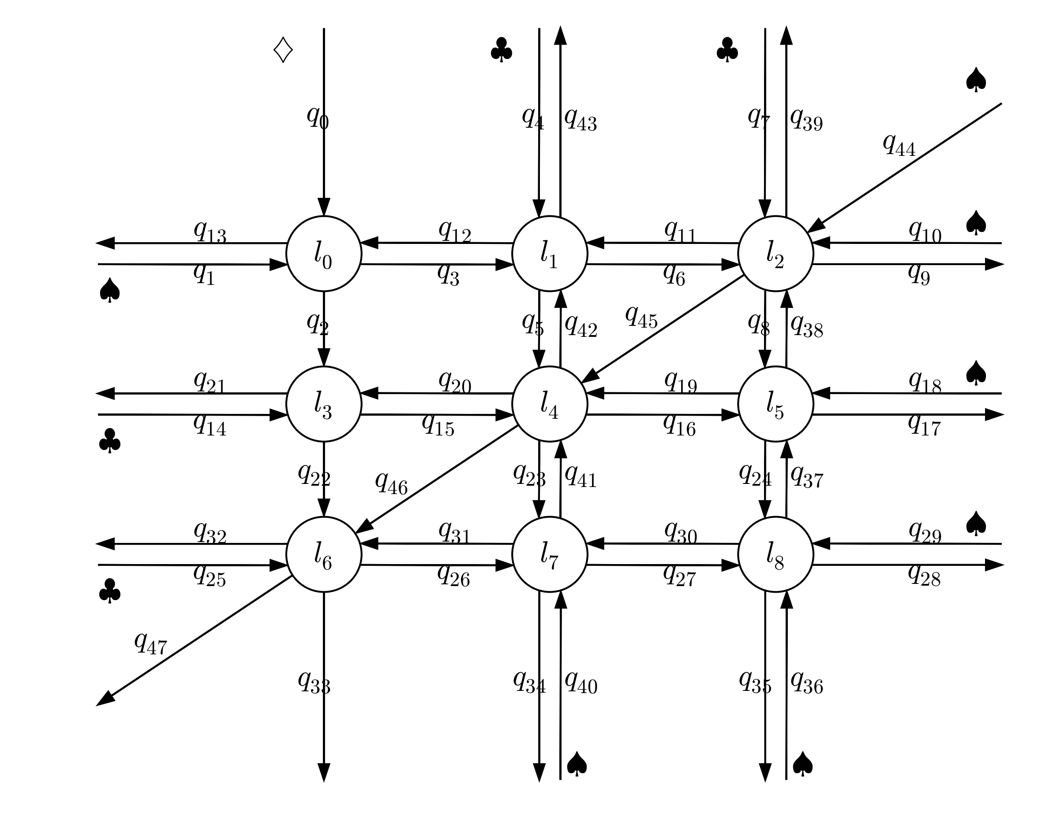
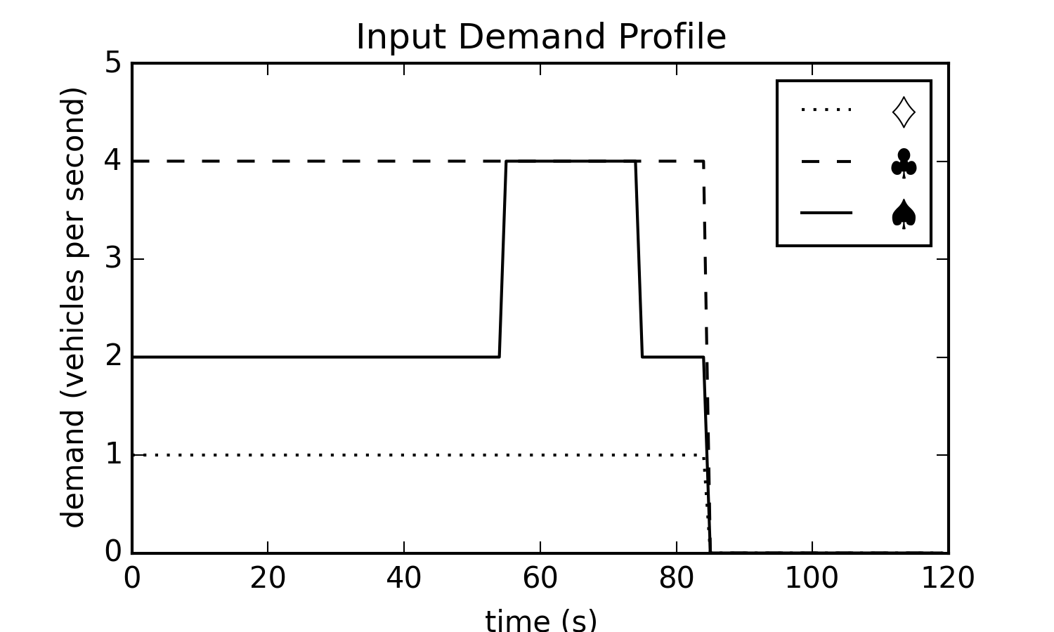
Experiments - Networks
Input Demand Profile

Slide 36
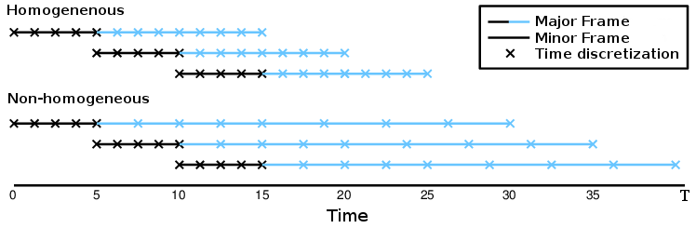
Experiments – Receding Horizon Control
Homogeneous steps
Non-Homogeneous steps

Slide 37

Experiments – Receding Horizon Control
Homogeneous steps
Non-Homogeneous steps
Executed control plan

Slide 38
Experiments – Receding Horizon Control
Homogeneous steps
Non-Homogeneous steps
Demand profile

Slide 39
Experiments – Optimal Reference
Directly solve single homogenous discretization as an optimal reference solution
single homogenous discretization

Slide 40
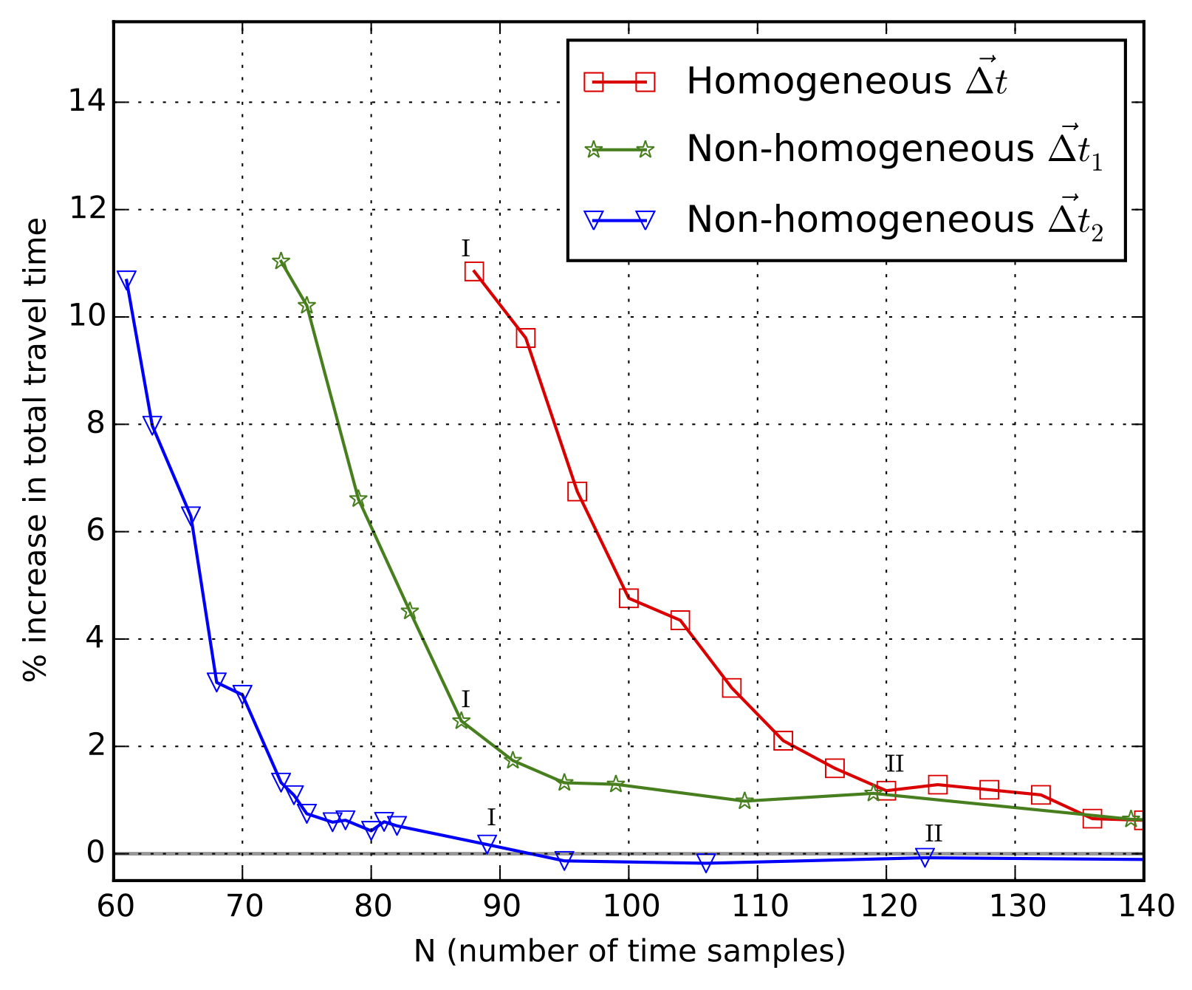
Results - Convergence
Increasing travel time
Non-
Homogeneous
Homogeneous
Non-
Homogeneous
Ref
Time samples / planning horizon

Slide 41
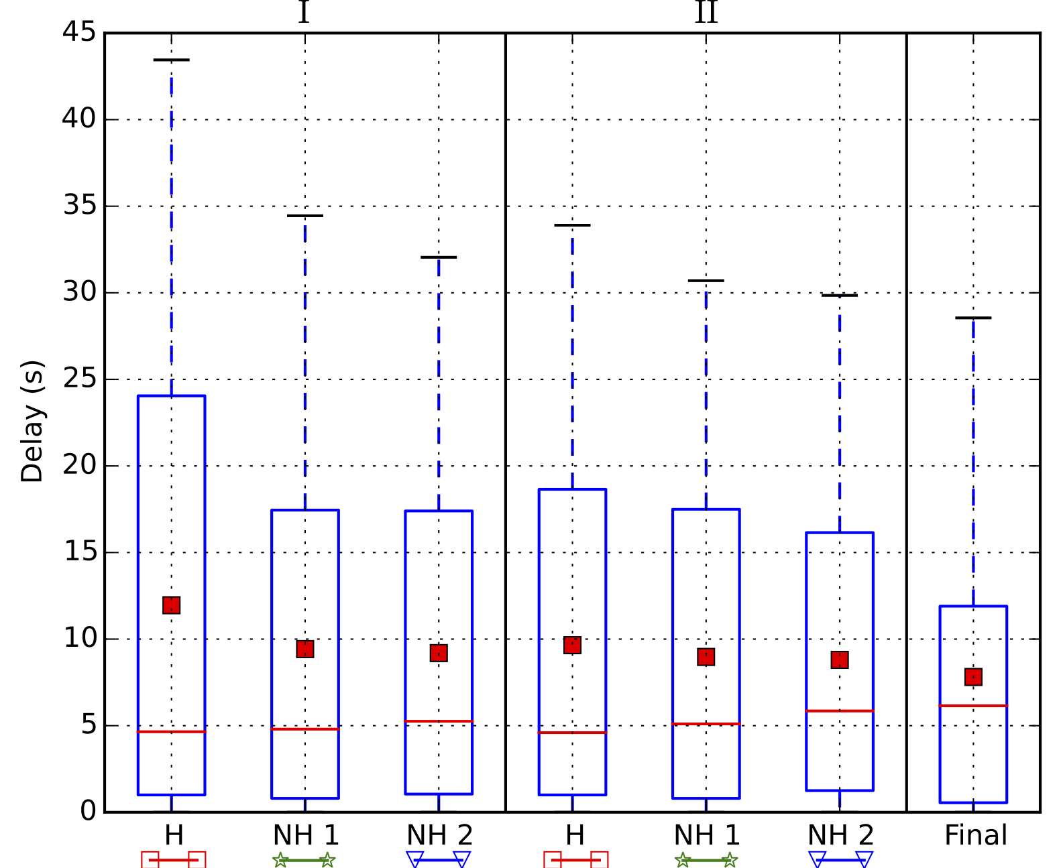
Results - Quality
F
Increasing travel time
Ref
Time samples / planning horizon

Slide 42
Extensions
Globally Optimal Fixed Time Control
Simulate fixed adaptive controllers (e.g. SCATS)
Pre-compute optimal schedules for fixed controllers
Light Rail Schedules
nullify the impact of introducing light rail
Uncontrolled intersections
Optimize via neighboring intersection signals

Slide 43
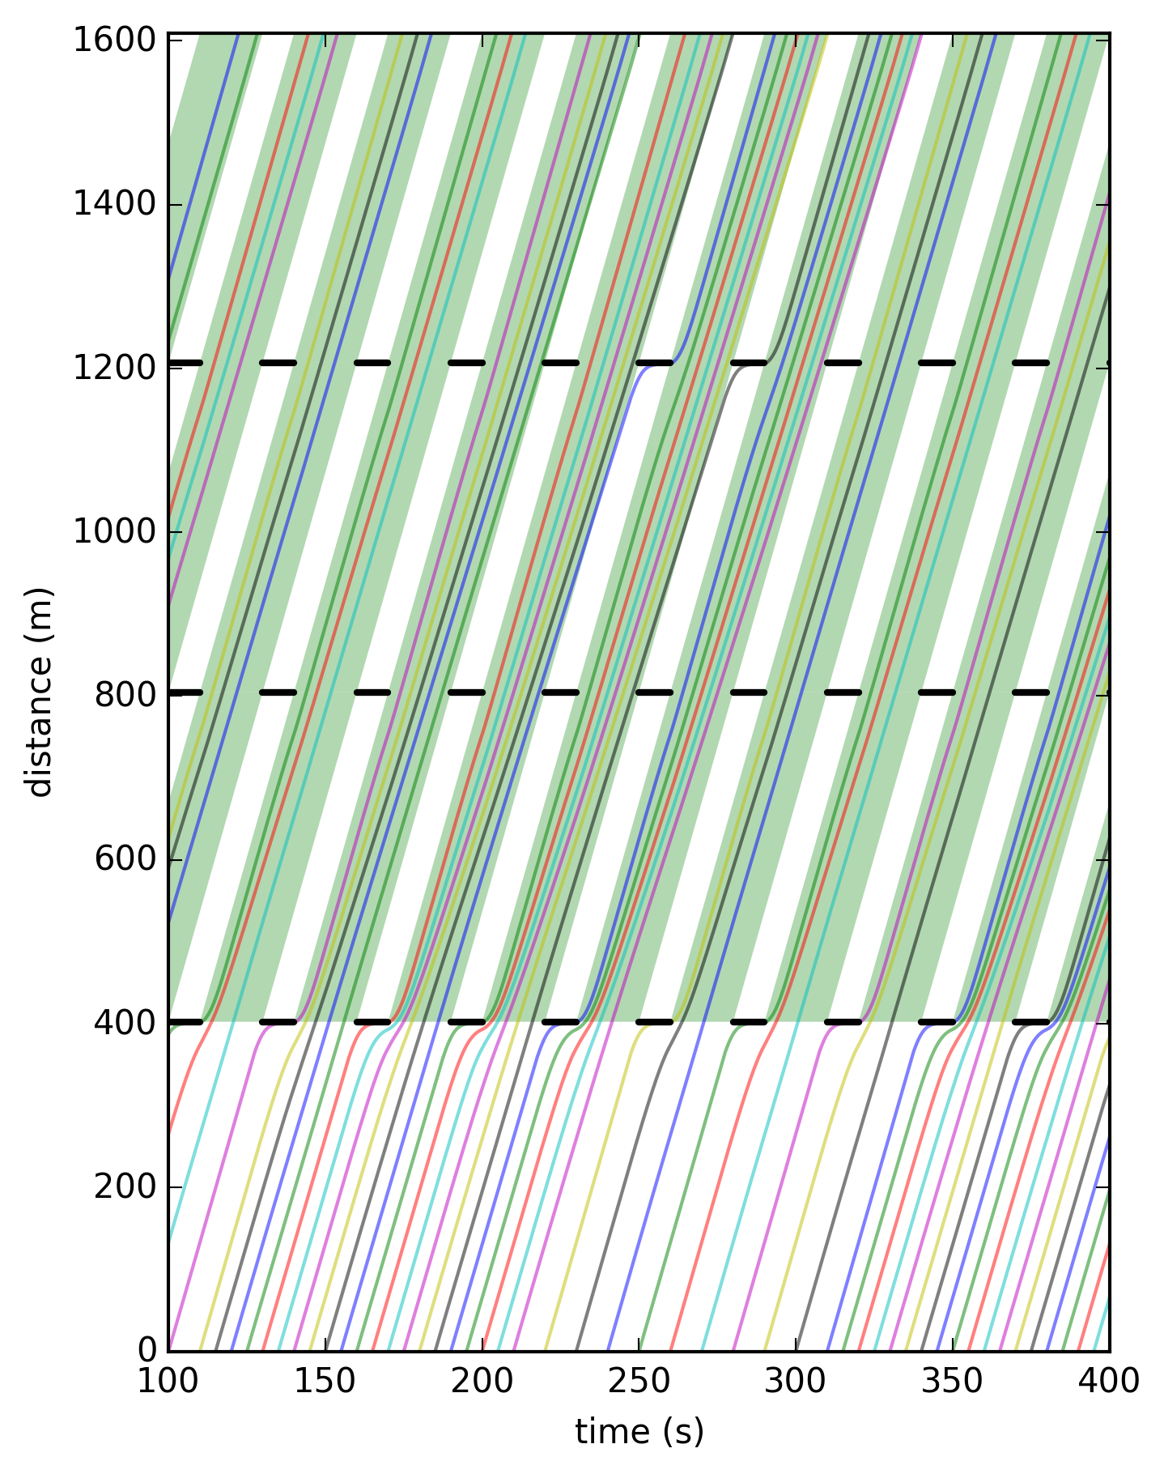
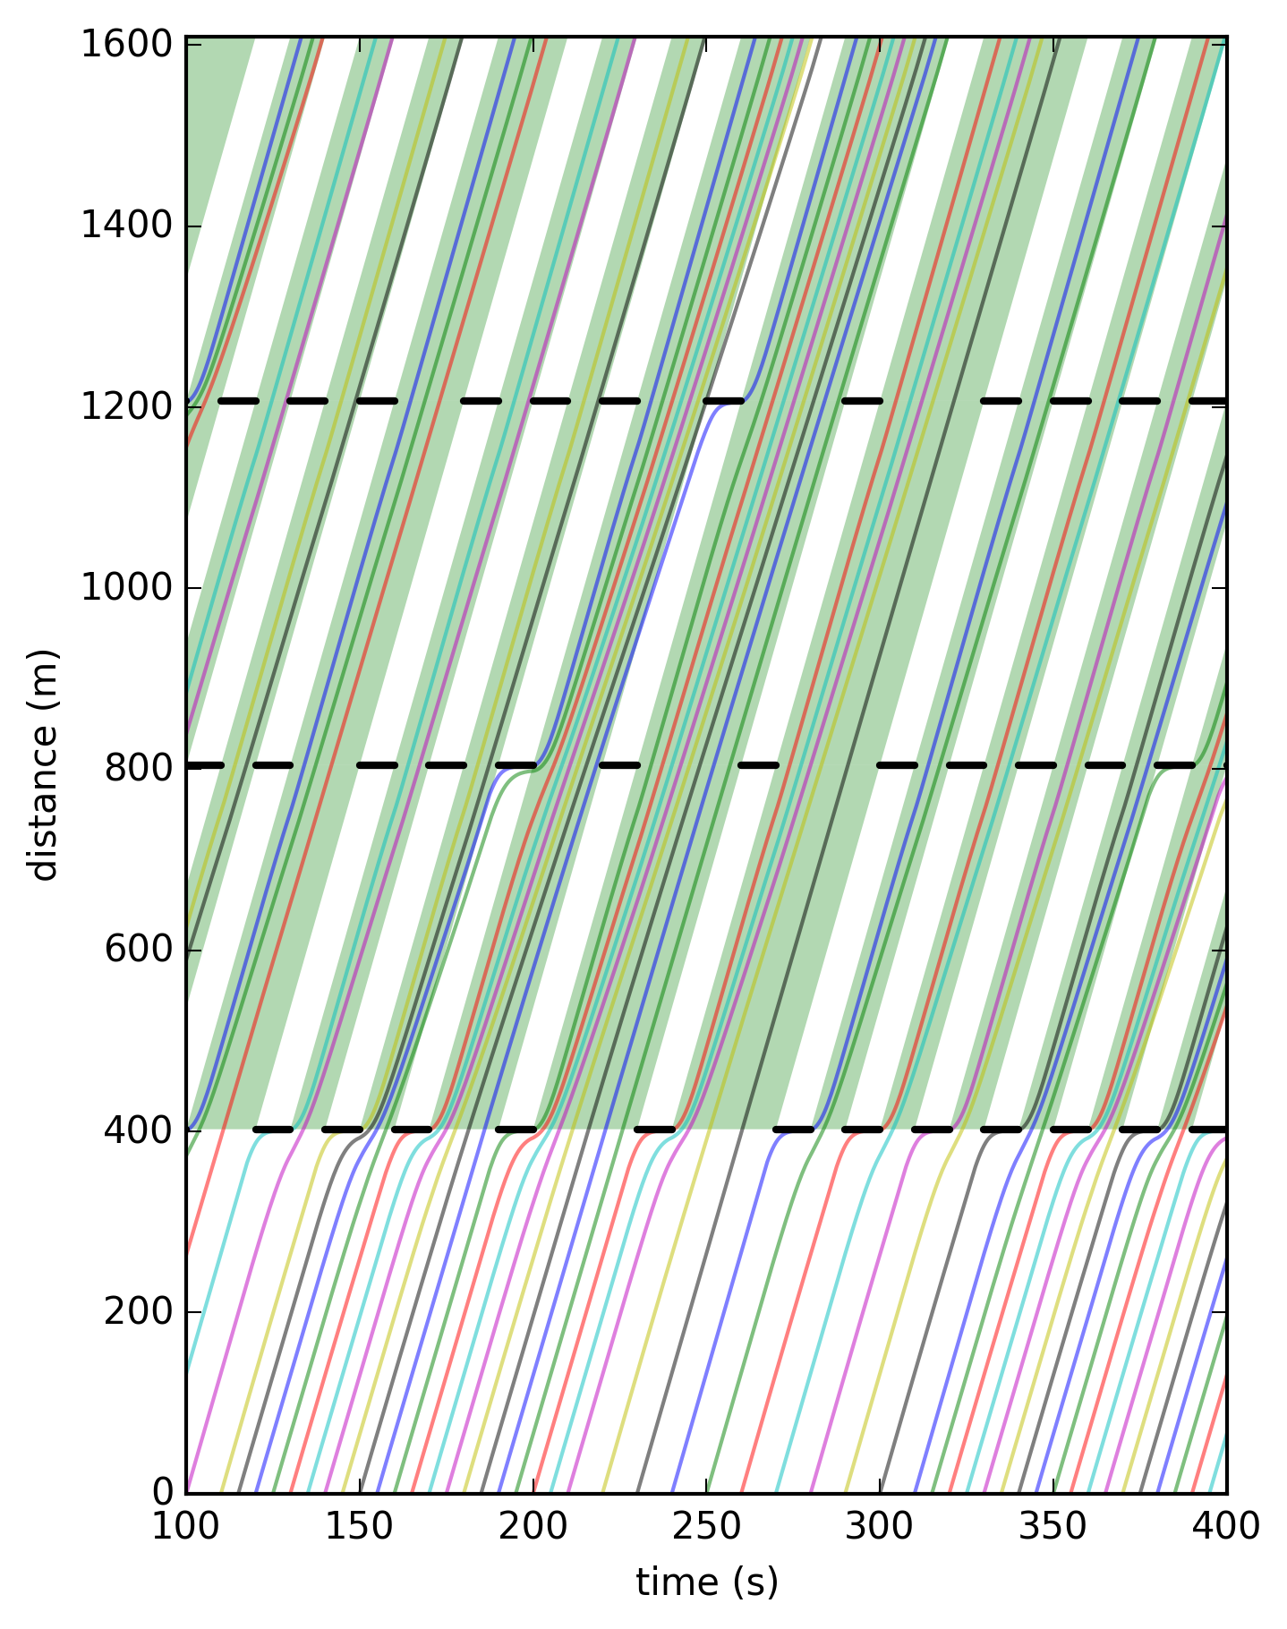
Globally Optimal Fixed Time Control
Fixed
Optimized
Distance
Distance
Time
Time

Slide 44
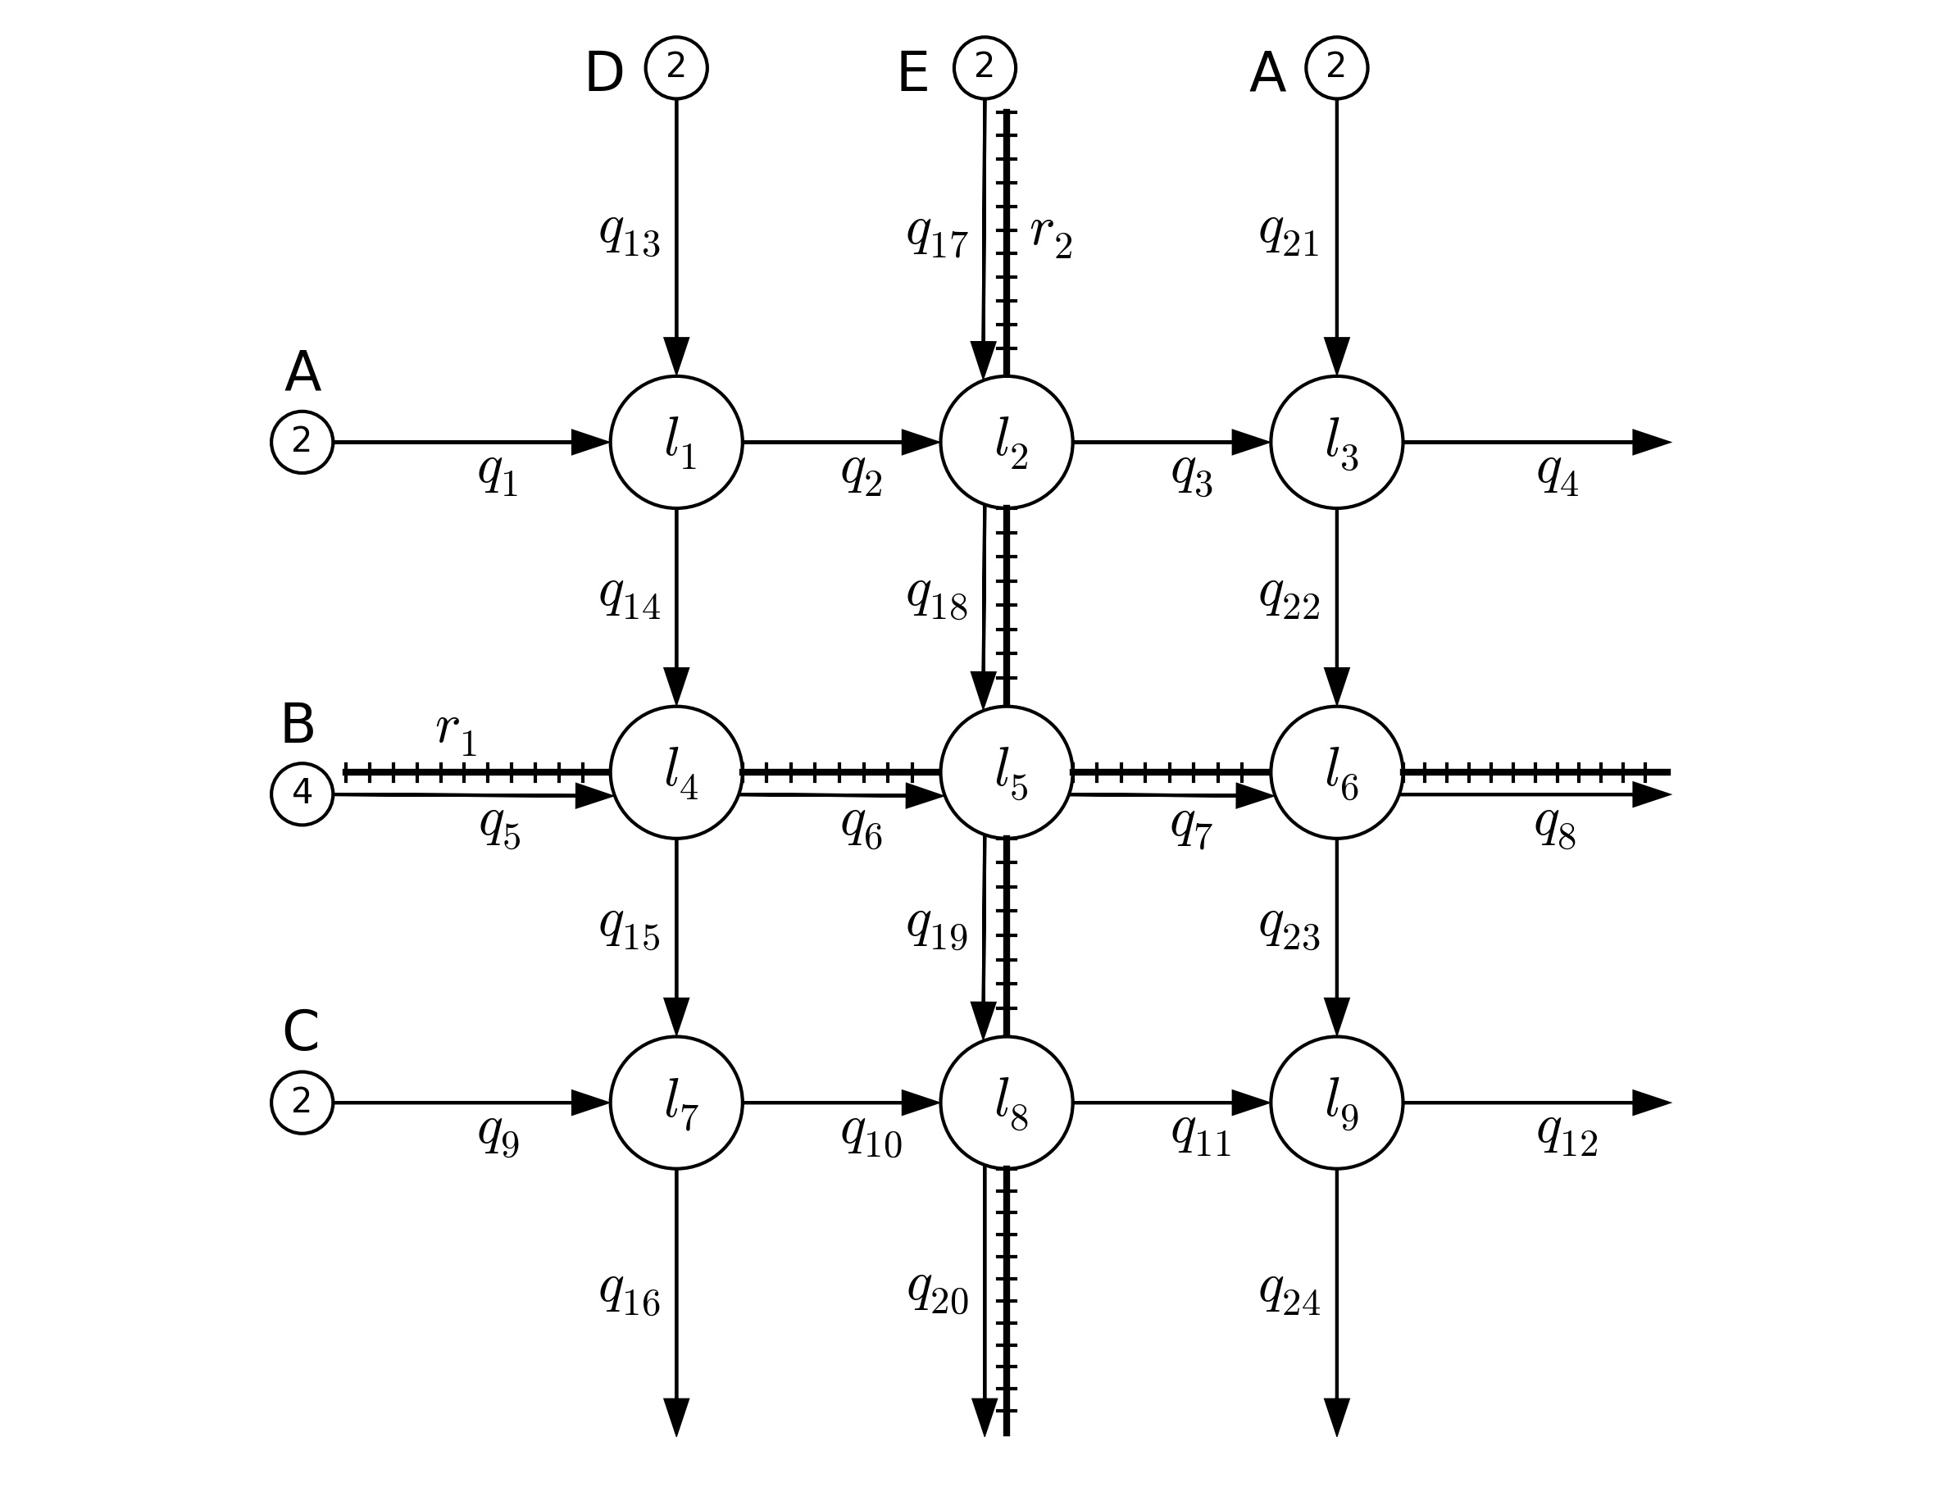
Light Rail

Slide 45
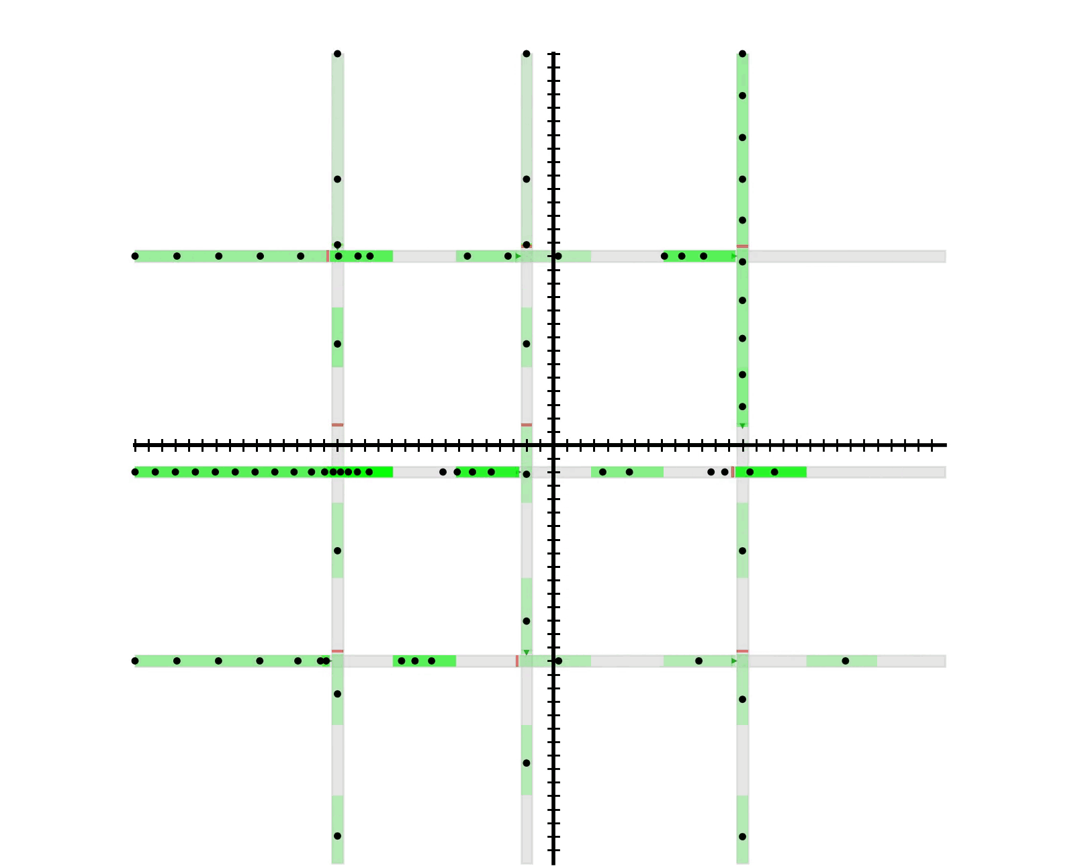
Light Rail

Slide 46
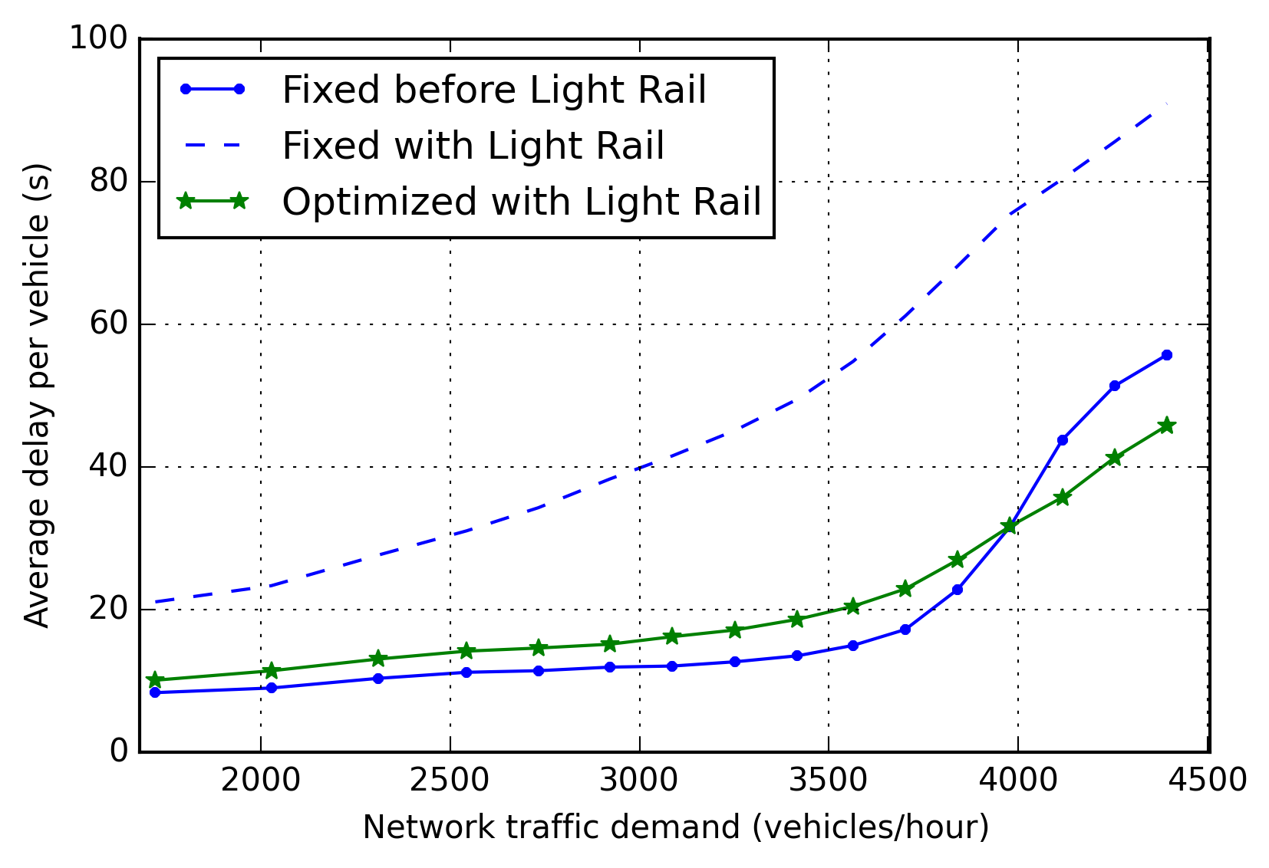
Light Rail – Delay
Delay
Fixed with L. Rail
Optimized with L. Rail
Fixed before L. Rail
Volume

Slide 47
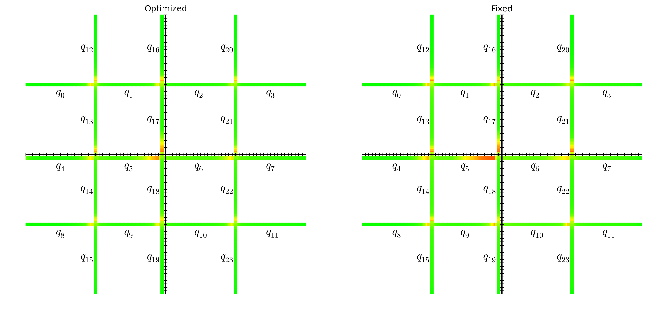
Light Rail – Delay Heat Map 3400 vph
Optimized
Fixed

Slide 48
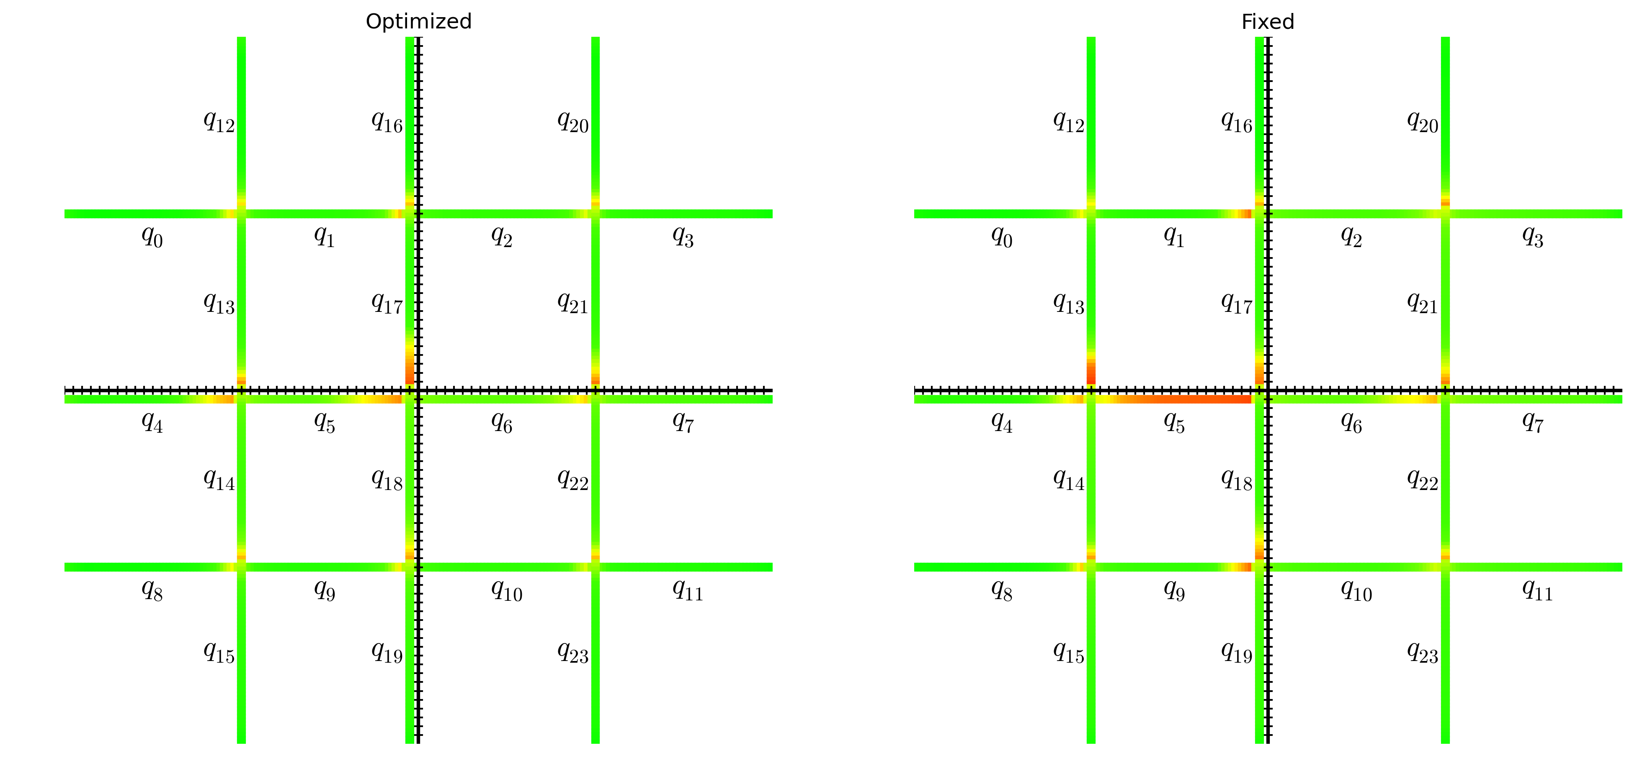
Light Rail – Delay Heat Map 4300 vph
Optimized
Fixed

Slide 49
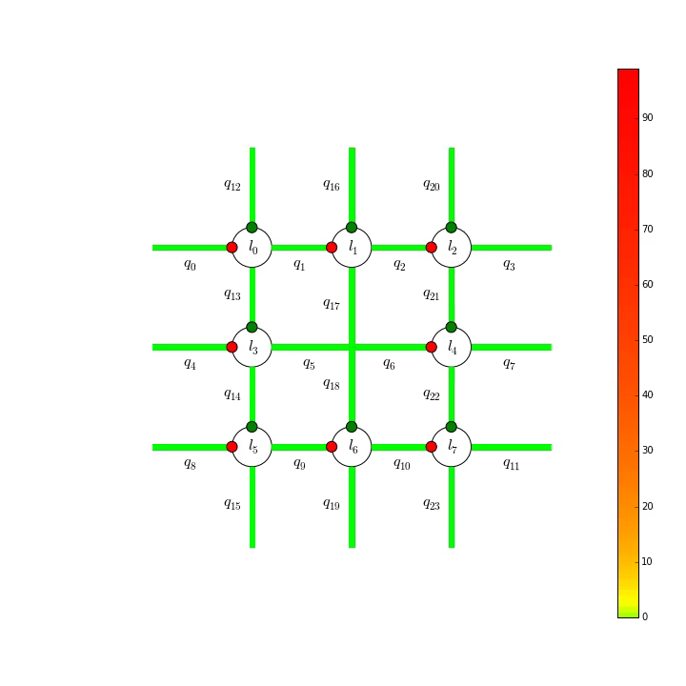
Uncontrolled Intersections

Slide 50
Conclusion
Presented Queue Transmission Model (QTM)
Globally optimal
Allows arbitrary topology
Scales to many intersections
Main insight: non-homogenous time discretization
Compared to homogeneous solution:
Faster convergence
Same or better solution quality
Extensions:
Globally optimal fixed time control
Mitigation of light rail impact
Coordination of uncontrolled intersections
Notes:
Compare optimized plans with SCATS/SCOOT to see if there is a better heuristic

Slide 51
Future Work
Solve iteratively
Close the loop with Model Prediction Control
learn parameters from loop and trace data
Initialize model state from microsimulator
Compare QTM:
with CTM and LTM MILP formulations
with SCATS
Scale Up
Use decomposition?
Code on Github:
github.com/iainguilliard/QTM_Traffic_Model
Notes:
Compare optimized plans with SCATS/SCOOT to see if there is a better heuristic

Slide 52
Thank you!
Questions?

Slide 56
Extras

Slide 57
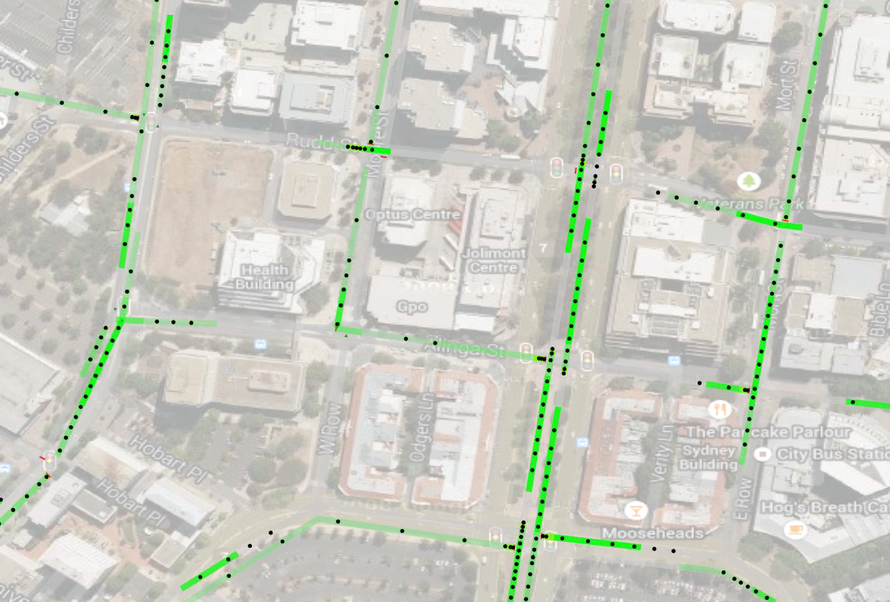
Example: Fixed Control with QTM flow

Slide 58
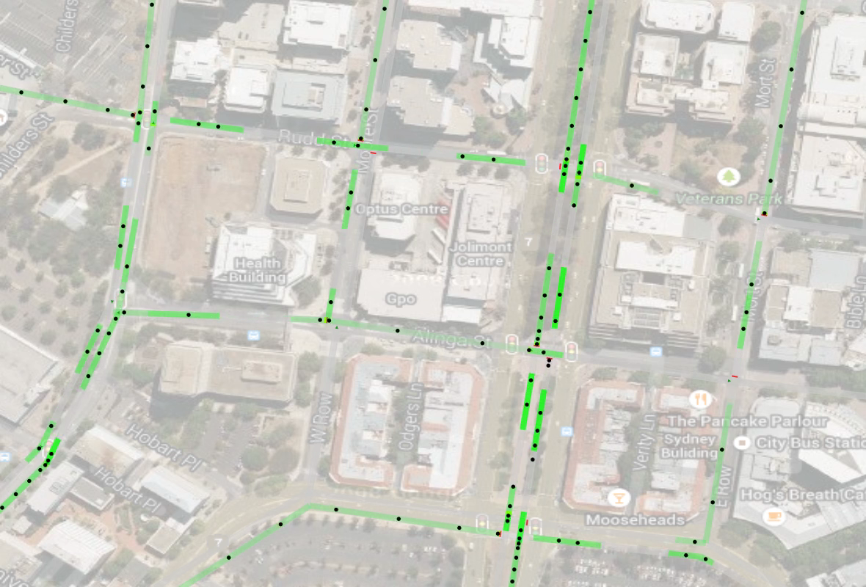
Example: QTM optimized control

Slide 59
Fixed Time Control

Slide 60
QTM Control

Slide 61
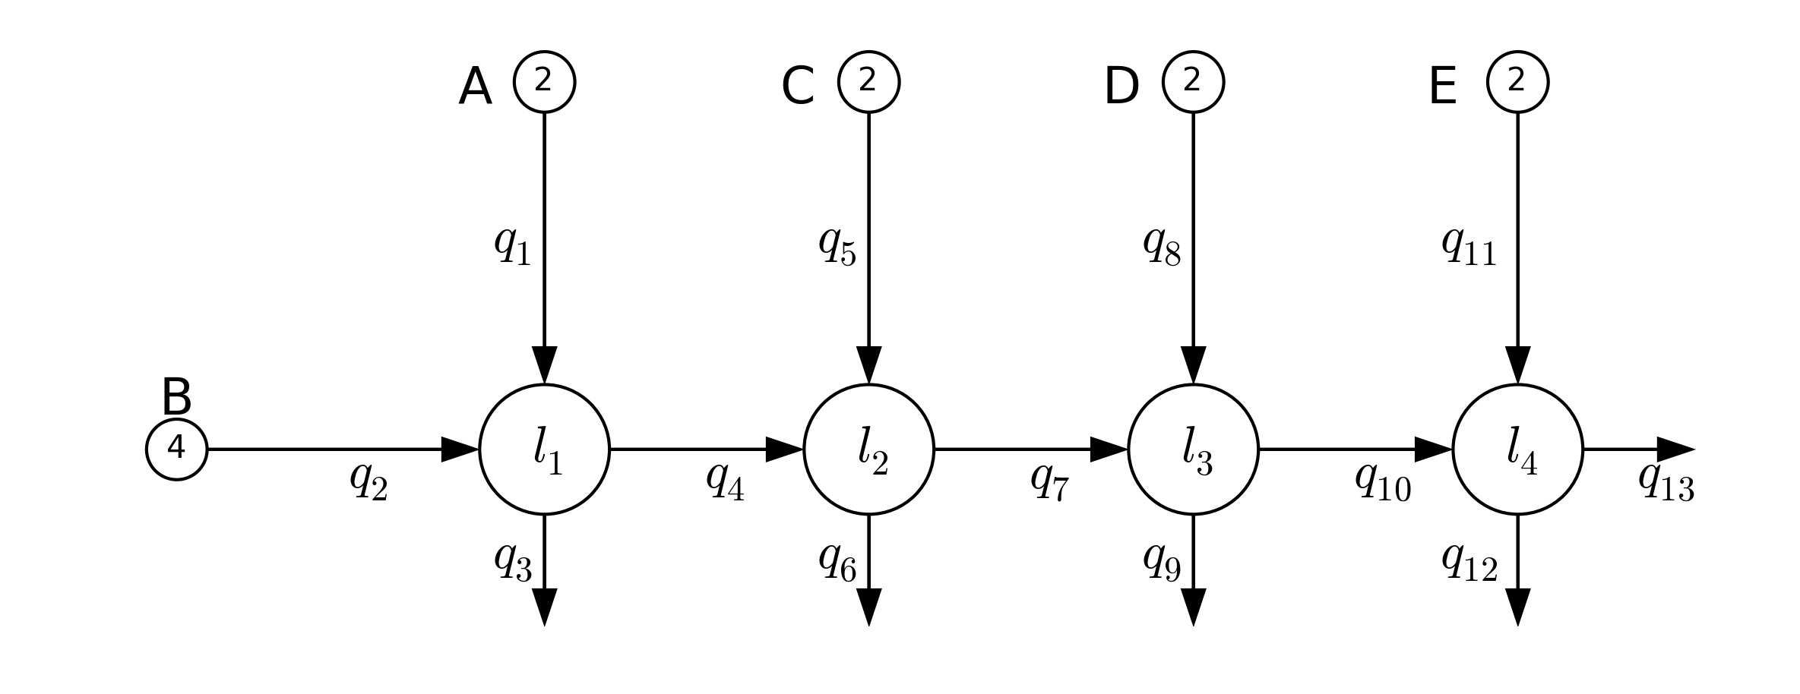
Globally Optimal Fixed Time Control

Slide 62

Fixed Time Control – micro-simulation
Distance
Time
Demand Profile

Slide 63


Light Rail – Network 1

Slide 64

Light Rail – Network 1

Slide 65

Light Rail – Network 1

Slide 66

Light Rail – Network 2

